Slide 1


TailorMatched
a sustainable clothing subscription model

Slide 2
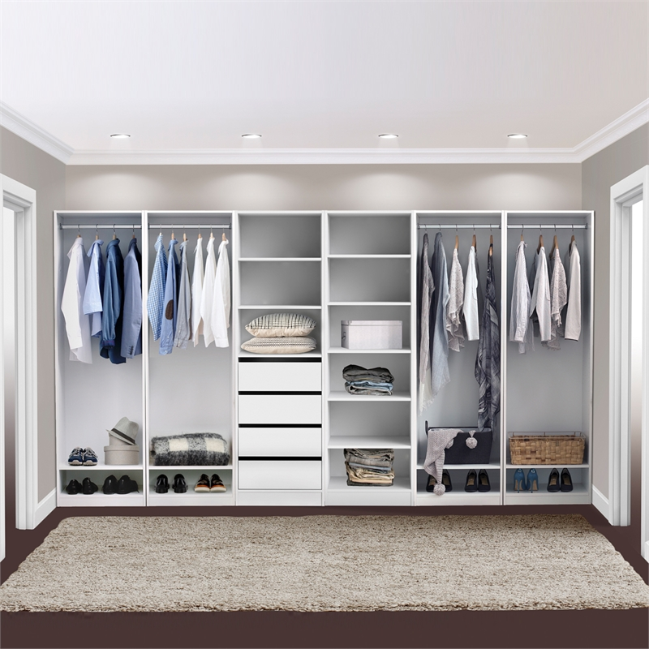


Model Breakdown
ANALYZE DATA
Scoured millions of data points to select the prime parameters to analyze.
CREATE MODEL
Implemented a logistic regression model to create a prediction engine.
COLLECT PROFILE
We make a profile of a customer through a quick survey.
RECOMMENDATION
Based off of the survey and our model, we create a personalized recommendation for every user.

Slide 3
THE NUMBERS BEHIND THE MAGIC
36%
15
300k+
ACCURACY
FACTORS
DATA POINTS
Probability that the model predicts the correct clothing item.
Characteristics of a customer utilized in the regression.
Unique customer purchases analyzed.

Slide 4
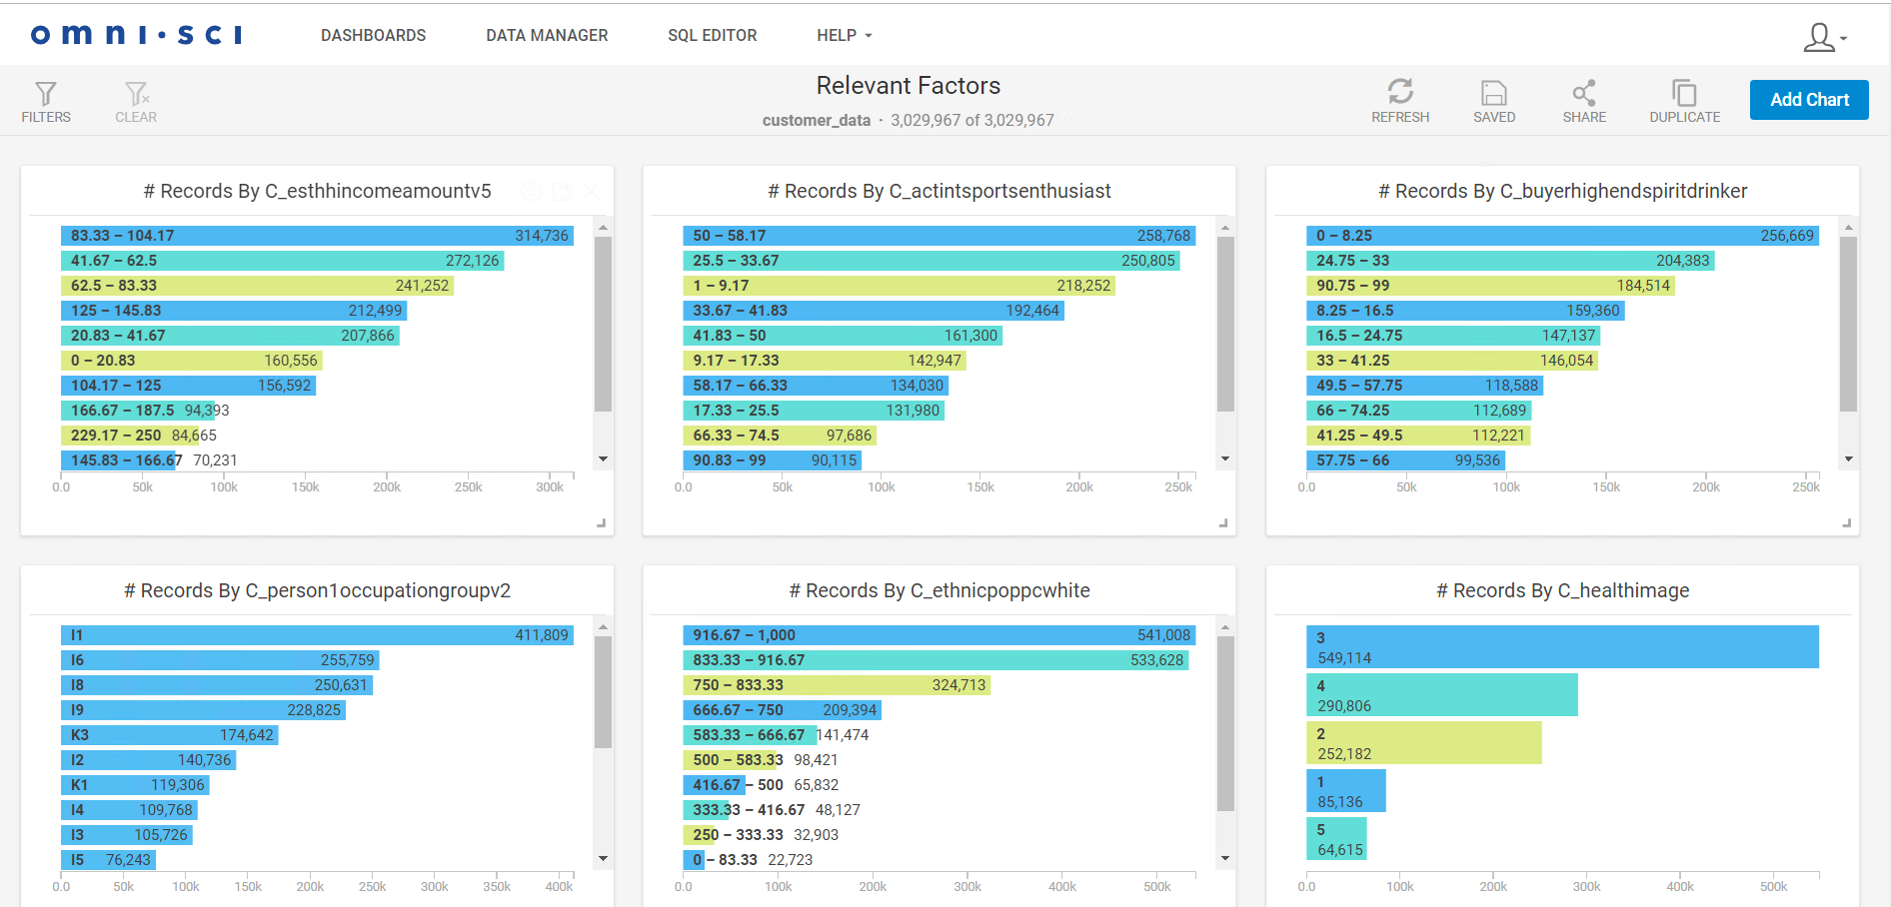
OmniSci Visualization

